Slide 1
Unit - II
Demand & supply analysis
Edited by Parul

Slide 2
Demand Analysis -
Demand = Desire + Ability to pay + Willingness to pay or to spend
Demand has THREE components –
Quantity demanded
Price
Time
S Nehra EFE Unit II
1
Notes:
1

Slide 3
2.1 Determinants / factors affecting or influencing demand
Price of a commodity -
Price of related goods – Substitute goods (AC & Cooler) & Complementary goods (Computer & software)
Income of the consumer -
Taste and preferences of the consumer – Jeans
Budget phones – Rs. 7,000 - 10,000
Kellogs’ - Launched chocos biscuits
Lacoste - Launched lacoste Kurtas
Rebook – Launched – Rs. 990 – Rs. 1790 range of shoes
McDonalds – Aloo Tikki
S Nehra EFE Unit II
1

Slide 4
Determinants / factors affecting or influencing demand
Consumer expectations –
Advertisement effects –
Climate or whether conditions – Ex - Cold Drinks, Coolers, Umbrellas
Population – Ex- More aged population will require more medicines
S Nehra EFE Unit II
1

Slide 5
Factors influencing market demand
Price of the product
Distribution of income and wealth in the society
Community’s common habits and scale of preferences
General standard of living
Numbers of buyers in the market and growth of population
Age structure and sex ratio of the population
Future expectations
Advertisements and sales techniques
S Nehra EFE Unit II
1

Slide 6
Review question - Factors affecting the demand for healthcare in an economy
Demand will depend on –
Price
Income
Population size and age distribution
Health needs
Balance between public and private provision
Attitudes to health
Awareness of availability of services
Government policy etc.
S Nehra EFE Unit II
1
Notes:
1

Slide 7
My answer
1 no
2 no
3 yes
4 yes
5 yes
6 yes
7 yes
8 yes

Slide 8
Review question
Factors affecting the demand for automobiles/cars in an economy
S Nehra EFE Unit II
1

Slide 9
My Answer
1 Income of people
2 price of car
3 availability of resources
4 climatic condition (hilly areas jeeps)
5 complementary goods (price of petrol diesel)
6 supplimentary goods (substitute car)
7 advertisement
8 population

Slide 10
Change in quantity demand
Movement along the same demand curve
Other things being equal, when there is a change in the price of the commodity, the resulting change in demand is shown along the same demand curve
When the price of commodity falls, its demand expands it is called as ‘extension of demand’.
When the price rise will result in the reduction of demand it is called as ‘contraction of demand’.
S Nehra EFE Unit II
1

Slide 11
Change / Shift in the demand curve
When the demand changes on account of the factors other than price, there will be a shift in the demand curve. This situation is termed as change in demand.
When, the demand of the product increases due to any other factor, it is called increase in demand.
When, quantity demanded falls due to factor other than rise in product price, it is called as decrease in demand.
S Nehra EFE Unit II
1

Slide 12
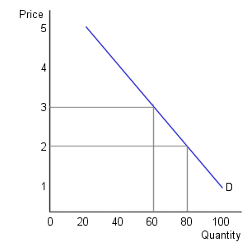
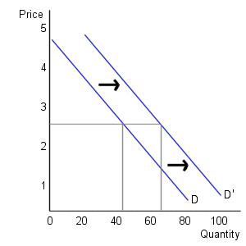
Change in quantity demanded vs. change in demand
Change in quantity demanded Change in demand
S Nehra EFE Unit II
1
Notes:
1

Slide 13
Review question – Movement & shift
The Microsoft Xbox 360 gaming console is getting its price slashed in India, making it all the more affordable for gamers who’ve been eyeing it for long.
When a XYZ Telecom company, offered reduced rates on weekends, its volumes of weekend calling risen sharply
People buy more long – stem roses in the week of the Valentine's day
Dell computer’s lowers its prices on all type of laptop models
The government mandates that regular bulbs can no longer be sold and the consumers make the switch to CFL bulbs
S Nehra EFE Unit II
1

Slide 14
With the commencement of summer, the demand for Coke increased, but with the appearance of newspaper reports regarding the bottle containing pesticides, the demand fell to less than normal level. How would you explain these developments, when the price of Coke has remain unchanged?
In a TV interview, a Doctor says garlic is health resistant to heart attacks. What will happen to demand for garlic? Which factor causes change in demand?
Is there any difference between a ‘rise in demand’ and ‘an increase in demand’ for Godrej hair colour in the Jaipur market.
S Nehra EFE Unit II
1

Slide 15
Four of the five events might reasonably be responsible in shifting the demand curve for coffee to a new position. Point out the one which would not shift the demand curve and why?
A fall in the price of tea
An increase in the money income of the consumers
A widespread advertisement campaign undertaken by the producers of coffee
A change in the habit of the consumers
A rise in the price of the coffee
S Nehra EFE Unit II
1

Slide 16
My Answer
1 Movement
2 Movement
3 Shift
4 movement
5 shift
6 shift
7 shift
8 rise in demand (movement)
Increase in demand (shift)
9 e) A rise in the price of the coffee

Slide 17
Law of demand
The law of demand explains the inverse relationship between the price and quantity demanded of the commodity.
Other things being equal, price and quantity demanded of a commodity move in the opposite direction.
S Nehra EFE Unit II
1

Slide 18
Assumptions of the law
No change in price of related goods – Substitute goods (AC and Cooler) & Complementary goods (Computer and software)
No change in Income of the consumer -
No change in taste and preferences of the consumer – Jeans
No change in consumer expectations – Ex – Cyclone and crude oil prices
No change in advertisement effects –
No change in climate or whether conditions – Ex - Cold Drinks, Coolers, Umbrellas
No change in population – Ex- More aged population will require more medicines
S Nehra EFE Unit II
1

Slide 19
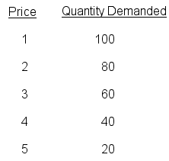
Demand Schedule – A tabular representation
S Nehra EFE Unit II
1

Slide 20
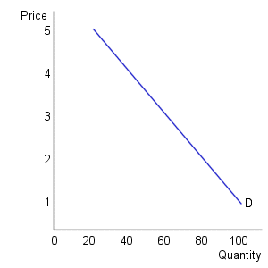
Demand Curve – A graphical representation
S Nehra EFE Unit II
1

Slide 21
Why demand curve slope downwards ?
Law of diminishing marginal utility – Consumer will prefer to buy additional unit only at lower price
Income effect – As the price of a commodity decreases, the real income of the consumer increases
Substitution effect –When price of any commodity increases while prices of other substitute goods remain unchanged, consumers would prefer any one of these substitute goods.
Entry and exit of new customers –
Various uses –Ex- Sugar, Electricity, Milk
S Nehra EFE Unit II
1

Slide 22
Exceptions of the law
Giffen goods/ Inferior goods – Demand for inferior goods like coarse grains, unbranded clothes will not increase even when their prices fall. All giffin goods are inferior goods and they dont have much of substitute.
Articles of distinction – Ex- Jewellery, Luxury goods
Veblen effect :status symbol , prestige.
Snob Effect : you want to be unique different , buy if its unique.
Demonstration effect : If your neighbour have then you have.
S Nehra EFE Unit II
1

Slide 23
Necessities of life – Ex- Foodgrains, Medicines
Future expectations regarding change in price – Gulf war, Chinese Olympics and steel
Ignorance / illusion – Stock clearance sale
Abnormal conditions – Ex- Wars, Famines, Flood

Slide 24
What will happen to demand for goods at the time of economy slow down ?
Real estate
Electronics
Luxury cars
Designers product
Travel and tourism
Restaurant business
Luxury market do shrink but not hard - hitted by economic slow down.
S Nehra EFE Unit II
1

Slide 25
My answer
1 Demand decreas,will be hitted hard, contraction of demand.
2 Demand Contraction
3 No effect , one who can buy will buy.
4 No effect , one who can buy will buy.
5 No effect , one who can buy will buy.
6 No effect , one who can buy will buy.

Slide 26
Review questions
Nike becomes very unpopular. What will happen to the demand for Reebok?
A firm offers 6 mugs by way of gift with every 500 gm pack of instant coffee. Name the products the demand for which will suffer a set back? How?
Imagine that you are a new global auto maker planning to enter the Indian market. List the various demand aspects you think are important.
Explain factors affecting – Mobile phones, Cars, TV, Computers.
Identify the major factors influencing market demand for – Ice Cream, Sugar, Jeans
S Nehra EFE Unit II
1

Slide 27
Over the years the demand for textiles in India has grown in spite of rising prices. How would you reconcile this fact with the law of demand.
Analyse the impact of market demand for cosmetics under the following circumstances
A change in the sex ratio of the population increasing the females against males in number
A general price rise in consumer product by 10 per cent
An increase in excise duties on cosmetics
A decrease in income tax on sales of electronic goods
An increase in the employment of women
S Nehra EFE Unit II
1

Slide 28
My Answer
1 Demand curve shifts right , increase in demand.
2 Other brand of coffee will suffer set back
3 Income of people , population, price of product, climatic conditions (hilly region or not), Advertisement ,
Taste (choice of people),complementary goods.
4 Income of people , population, price of product, climatic conditions (hilly region or not), Advertisement ,
Taste (choice of people),complementary goods.
5 Income of people , population, price of product, climatic conditions (cold region or warm region), Advertisement ,
Taste (choice of people),
complementary goods(cost of milk for icecream etc.).
6 It is an exception./population or prefferences of users.
7 a) increse
b) decrese
c) decrese
d) No change
e) increse

